Slide 1

YOUTUBE SONG ANALYSIS
With Power BI
BY MUHAMMAD AMMAR AHMAD

Slide 2
PROBLEM STATEMENT
This internship project aims to conduct a comprehensive analysis of YouTube songs data using Power BI.The dataset contains key attributes such as video ID, channel title, title, description, tags, published date,view count, like count, favorite count, comment count, video duration, videodefinition, and captiondetails.
The goal is to utilize Power BI to create insightful visualizations and reports that provide a deeperunderstanding of YouTube songs' performance,popularity, and user engagement. The analysis aims to uncover trends, preferences, and patterns in the data to aid content creators and stakeholders in optimizing their YouTube song content.

Slide 3
PROJECT OBJECTIVES
DATA CLEANING AND PREPERATION
EXPLORATORY DATA ANALYSIS (EDA)
CONTENT AND CHANNEL ANAYSIS
- Clean and preprocess the dataset, handling missing values or outliers.
- Convert relevant columns to appropriate data types.
- Explore patterns and distributions in view counts, like counts, and comments.
- Identify trends in the popularity and engagement of YouTube song videos.
- Analyze the distribution of videos across different channels.
- Identify popular tags and their correlation with view counts.

Slide 4
PROJECT OBJECTIVES
USER ENGAGEMENT INSIGHTS
TEMPORAL TRENDS
- Explore how YouTube song video metrics vary over time.
- Identify peak publishing times and their impact on engagement.
- Investigate relationships between likes, comments, and views.
- Identify factors influencing user engagement with YouTube song videos.

Slide 5
DATASET DETAILS
1. video_id: Unique identifier for each YouTube video.
2. channelTitle: Title of the YouTube channel publishing the song.
3. title: Title of the YouTube song video.
4. description: Description provided for the YouTube song video.
5. tags: Tags associated with the YouTube song video.
6. publishedAt: Date and time when the YouTube song video was published.
7. viewCount: Number of views received by the YouTube song video.
8. likeCount: Number of likes received by the YouTube song video.
9. favoriteCount: Number of times the YouTube song video has been marked as a favorite.
10. commentCount: Number of comments posted on the YouTube song video.
11. duration: Duration of the YouTube song video.
12. definition: Video definition or quality (e.g., HD, SD).
13. caption: Availability of captions for the YouTube song video.

Slide 6
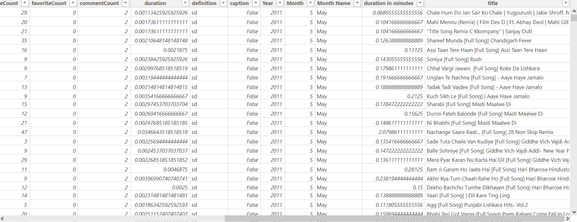
DATA CLEANING AND TRANSFORMATION
Removal of Null Values
Unnessesary Column Removal
Data types Adjustments
New Columns for better insights
OVERVIEW OF CLEAN DATA:

Slide 7
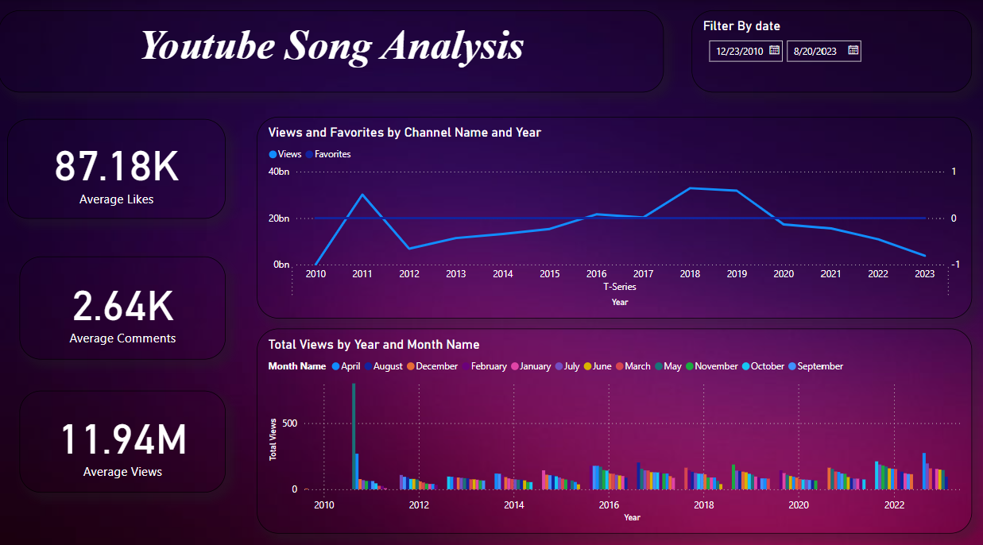
DASHBOARD 1

Slide 8
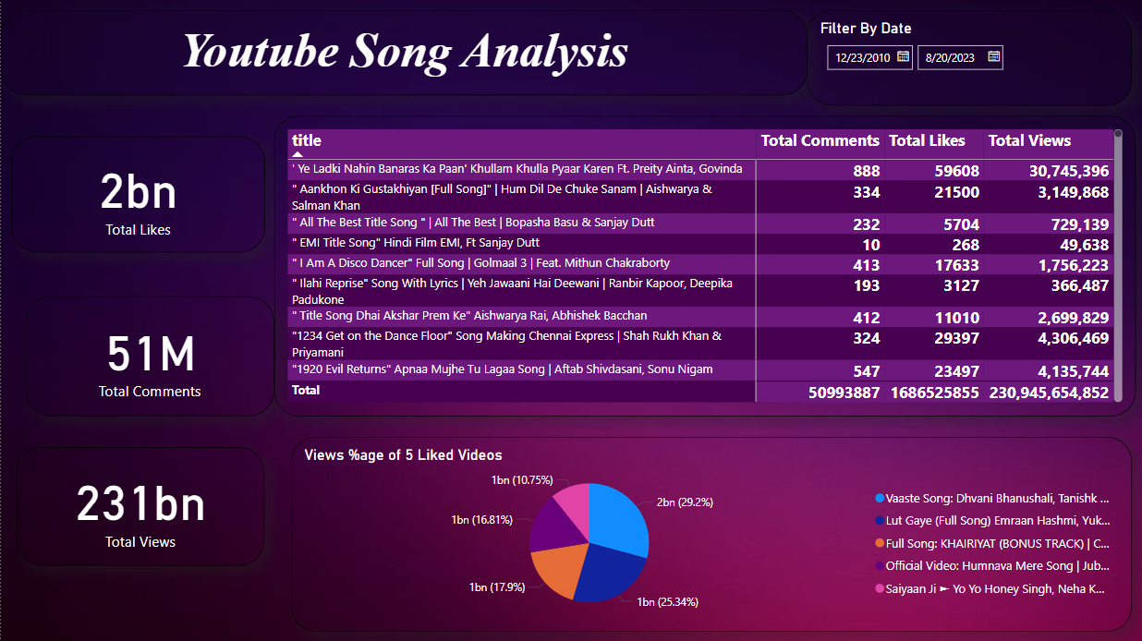
DASHBOARD 2

Slide 9
OUTCOMES
Peak Engagement Periods:
April 2010 shows a significant spike in views, indicating a potential high engagement period that could be leveraged for future releases.
Channel Performance:
T-Series dominates the YouTube song landscape with notable peaks around 2010 and continuous growth post-2014. Other channels might focus on collaboration or learning from T-Series strategies.
Content Strategy:
Classic songs like 'Ye Ladki Nahin Banaras Ka Paan' still hold high popularity. Content creators could explore remixing or creating new content around these classic hits.
Analyzing tags and descriptions of top-performing videos might provide insights into keywords and themes that attract more engagement.

Slide 10
OUTCOMES
User Engagement Insights:
High correlation between likes and views indicates the importance of engaging content that encourages users to like the videos.
The top 5 liked videos have a significant portion of total views, suggesting that focusing on content that drives likes could substantially increase view counts.
Temporal Trends:
Understanding the distribution of views over different months can help in planning release schedules. For example, if certain months consistently show higher engagement, those periods can be targeted for major releases.

Slide 11
THANKYOU!

